Slide 1
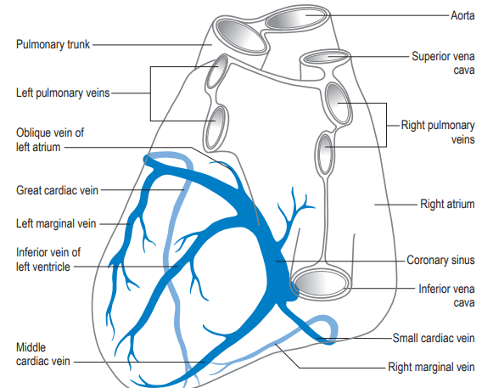
VENOUS SYSTEM OF HEART
PRESENTED BY:Dr AJMAL
CHAIRED BY:Dr KADER MUNEER

Slide 2
RFERENCES
Moss and Adams Heart Disease in Infants, Children and adolescents, 9th edition
Perloffs Clinical recognition of Congenital heart disease, 6th edition
Textbook of Human Anatomy and Clinical Embryology by Vishram Singh
Corrigendum to “Cardiac veins, an anatomical review” [Transl. Res. Anat. 23C (2021) 100096](Mohammad W. Kassem, Sasha Lake, Wallisa Roberts, Sonja Salandy, Marios Loukas https://doi.org/10.1016/j.tria.2020.100096)
Congenital Anomalies of the Coronary Sinus: A Pictorial Essay-Jung Eun Lee, MD, Se Hwan Kwon, MD, Joo Hyeong Oh, MD, Korean Society of Radiology 2013
Braunwald’s Heart diseases,a textbook of Cardiovascular Medicine ,12th edition
Gray’s Anatomy,41st edition

Slide 3
PLAN
EMBRYOLOGY
CONGENITAL ANOMALIES
ANATOMY OF CARDIAC VEINS
CLINICAL IMPORTANCE
RECENT ADVANCES

Slide 4
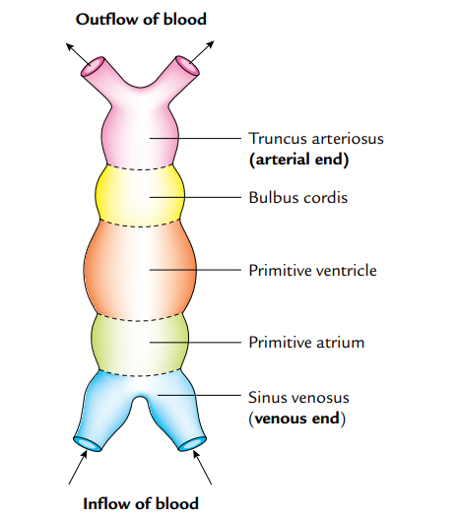
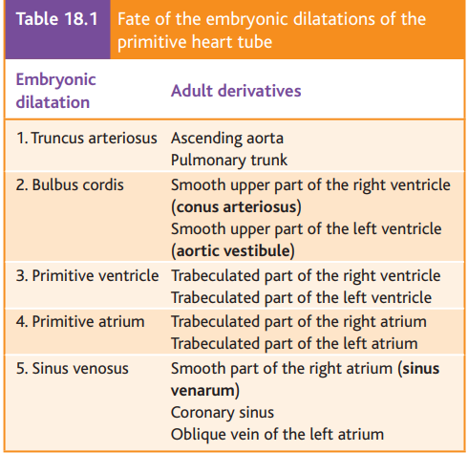

Slide 5
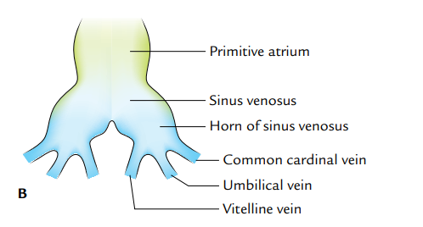
DEVELOPMENT
Raw material: 3 Primitive veins in the embryo on either side
1)From Placenta:Umblical veins--(oxygenated blood)
2)From Yolksac (Future Gut) of embryo: Vitelline veins
(Omphalomesenteric vein)
3)From the body wall of embryo: Common cardinal veins-
Form Visceral veins
Form somatic veins

Slide 6
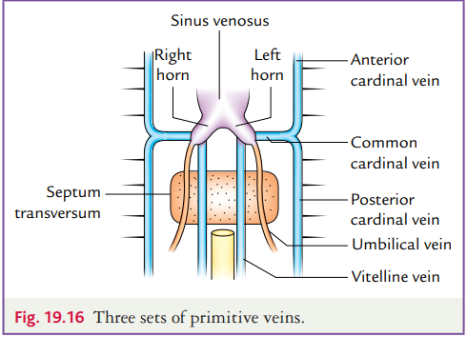

Slide 7
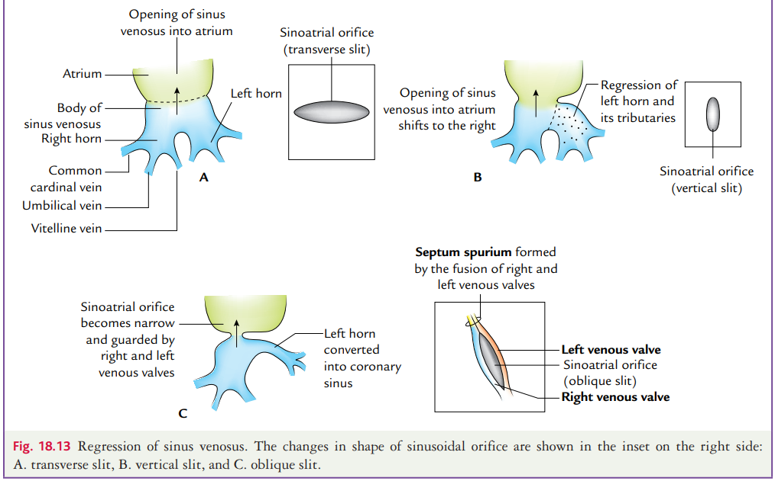
FATE OF SINUS VENOSUS

Slide 8
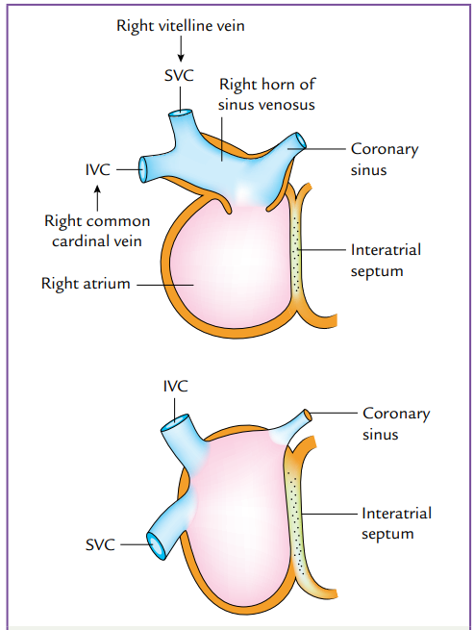
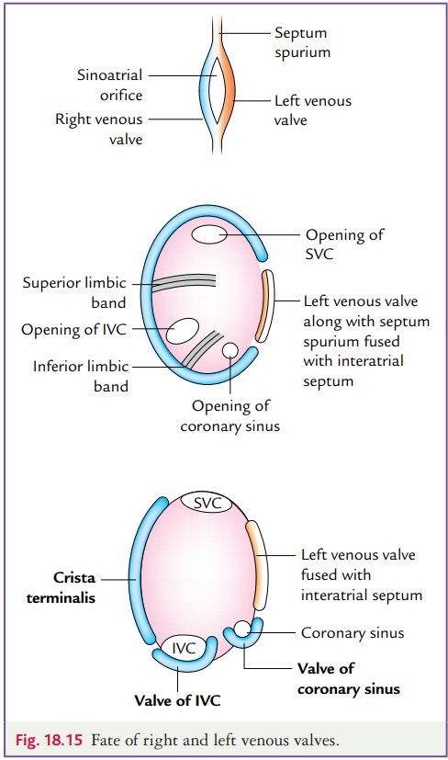

Slide 9
Right horn of sinus venosus receives all the systemic venous blood through superior and inferior vena cava.
Left horn becomes coronary sinus.
After formation of interatrial septum the right horn and body of sinus venosus are absorbed into the right atrium so that superior vena cava inferior vena cava and coronary sinus (regressed left horn) now open in the right atrium.
The left venous valve fuses with the interatrial septum.
The right venous valve is stretched out to from (a) crista terminals,
(b) valve of IVC, and(c) valve of coronary sinus.

Slide 10
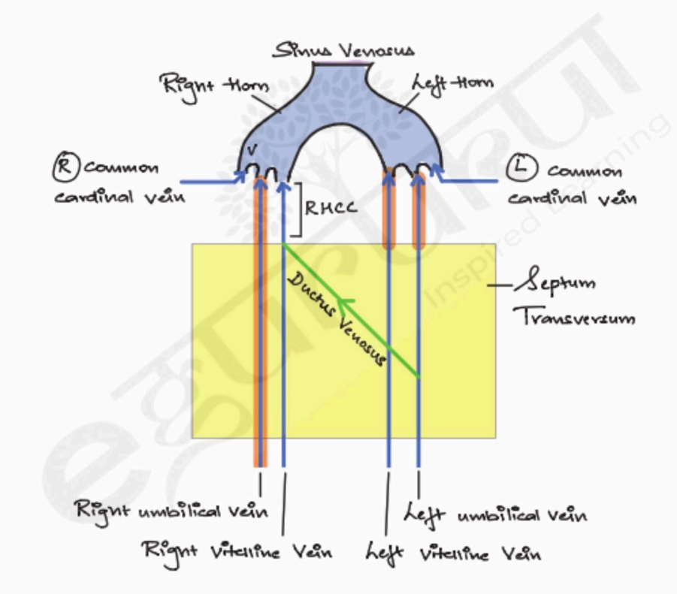
FATE OF UMBLICAL VEINS
They carry oxygenated blood from the placenta to the fetus and open into right and left horns of the sinus venosus..
With the development of liver in the septum transversum, the umbilical veins are absorbed and broken up within the septum transversum.
The parts of umbilical veins distal to septum transversum and the remaining right umbilical vein disappear so that only left carries blood from the placenta to the liver. (LEFT IS LEFT).

Slide 11
When there is an increase in placental circulation, to bypass the liver sinusoids, a large passage is formed between left umbilical vein and right hepatocardiac channel. This passage is called ductus venosus.
After birth,
Left umbilical vein obliterates to form ligamentum teres
Ductus venous obliterates to form ligamentum venosum

Slide 12
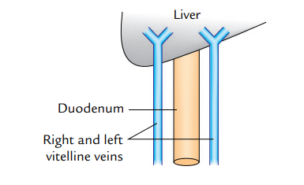
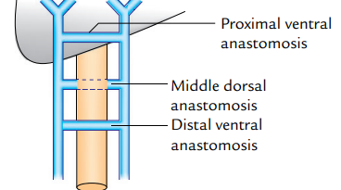
FATE OF VITELLINE VEINS
Omphalomesenteric vein---Vein of future gut.
The two vitelline veins lie one on either side of developing duodenum.
They get interconnected by three anastomotic channels.
Proximal ventral anastomosis
Middle dorsal anastomosis
Distal ventral anastomosis

Slide 13
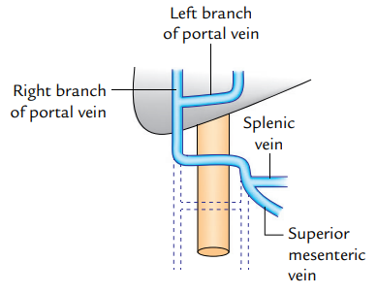
Portal vein develops from three components:
1. Caudal part of left vitelline vein at which superior mesenteric and splenic vein open.
2. Middle dorsal anastomosis.
3. Part of right vitelline vein between the dorsal and proximal ventral anastomosis.
The right branch of portal vein develops from the part of right vitelline vein distal to proximal ventral anastomosis.
The left branch of portal vein develops from proximal ventral anastomosis and left vitelline vein distal to proximal ventral anastomosis.

Slide 14
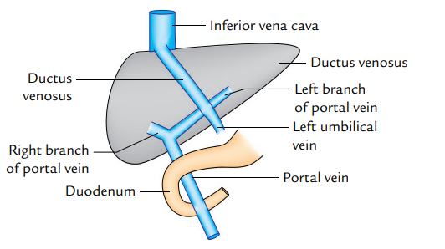
DERRIVATIVES OF VITELLINE VEINS
Portal Vein
Branches of Portal vein
Sinusoids of liver
Central Veins
Hepatic veins
Terminal portion of IVC.

Slide 15
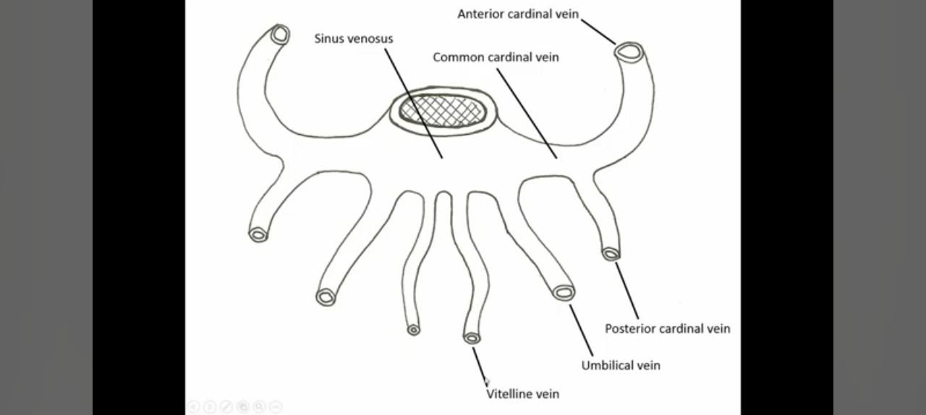
FATE OF CARDINAL VEINS
Right and left anterior cardinal veins that drain venous blood from cranial part of the embryo.
Right and left posterior cardinal veins that drain the venous blood from caudal part of the embryo.
The anterior and posterior cardinal veins on each side join to form common cardinal vein (or duct of Cuvier).
The right and left common cardinal veins open into the right and left horns of the sinus venosus.

Slide 16
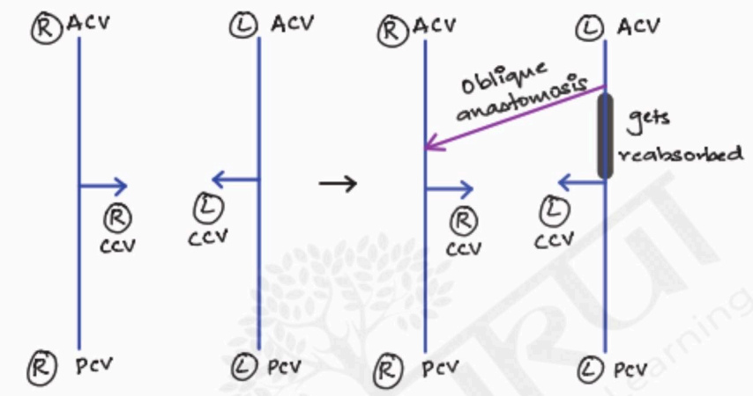
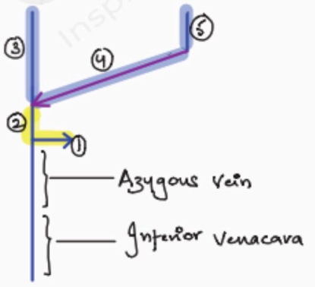
FATE OF ANTERIOR AND COMMON CARDINAL VEINS
Regress
Subclavian vein develops by the enlargement of intersegmental vein in the region of upper limb bud.
Internal jugular vein develops from anterior cardinal vein cephalic to the opening of the subclavian vein.
SVC: Rt CCV (1)+ Proximal RtACV (2)
Rt Brachiocephalic vein: Distal Rt ACV (3)
Lt Brachiocephalic vein :Oblique anastomosis (4) +Distal Lt ACV (5)

Slide 17
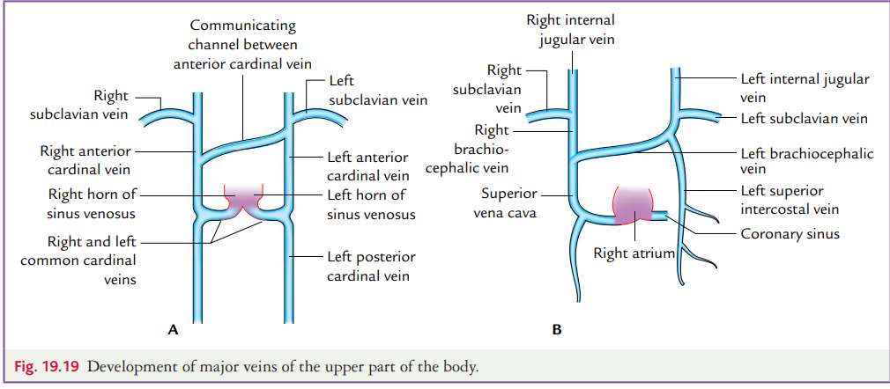

Slide 18
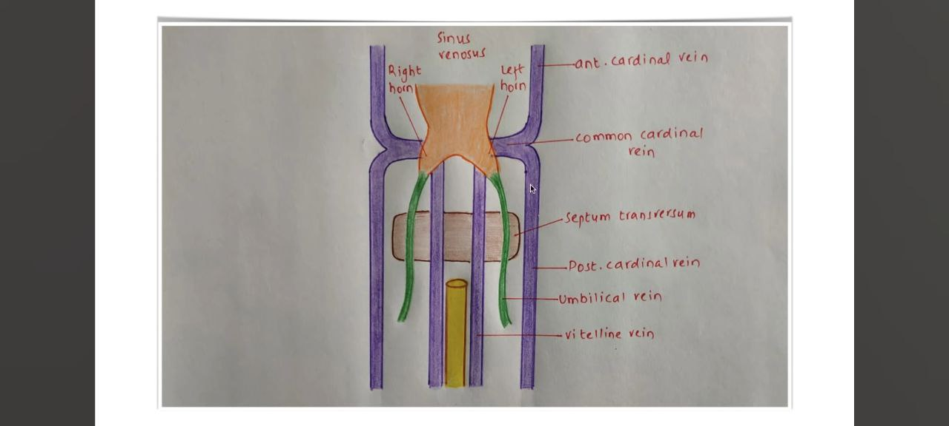
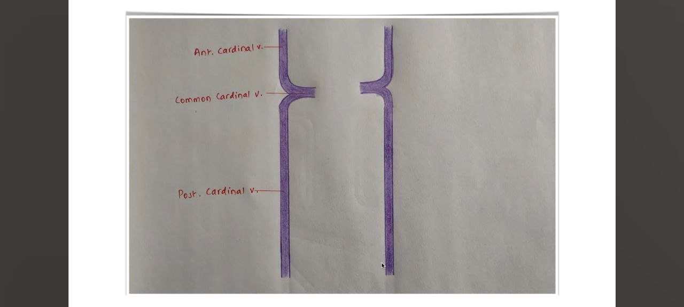
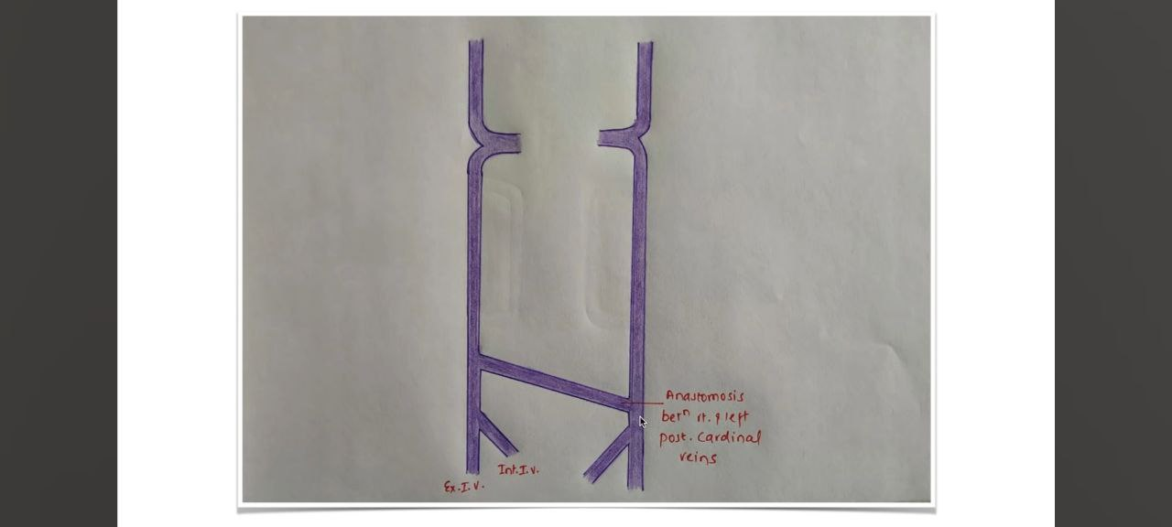
FATE OF POSTERIOR CARDINAL VEINS

Slide 19
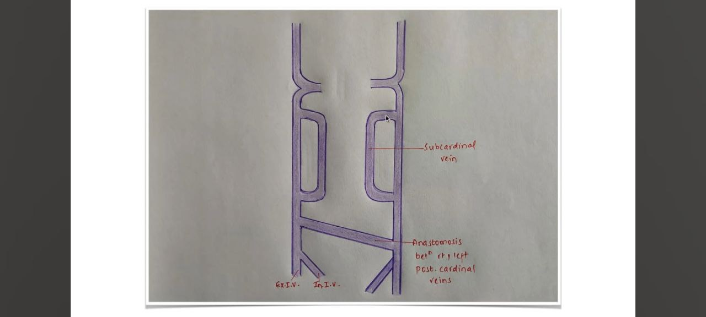
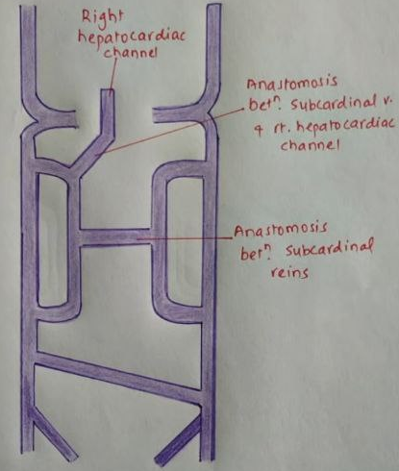
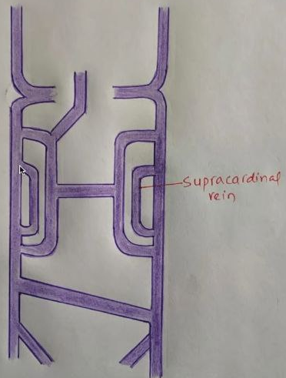

Slide 20
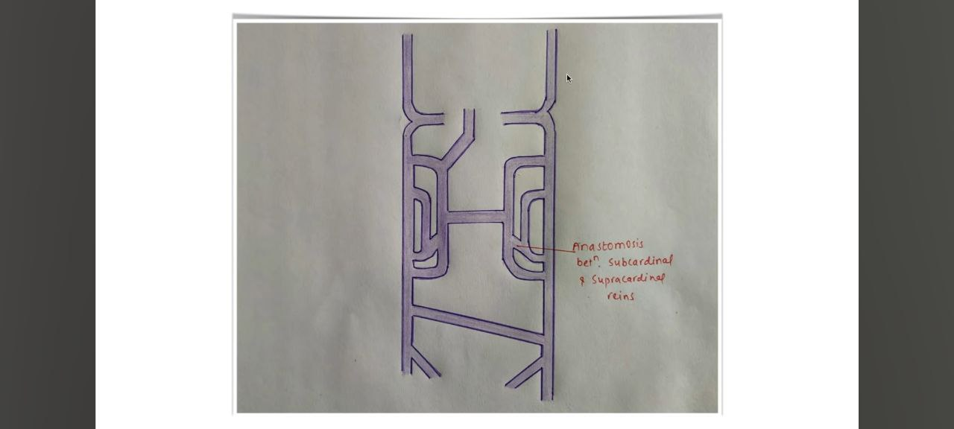
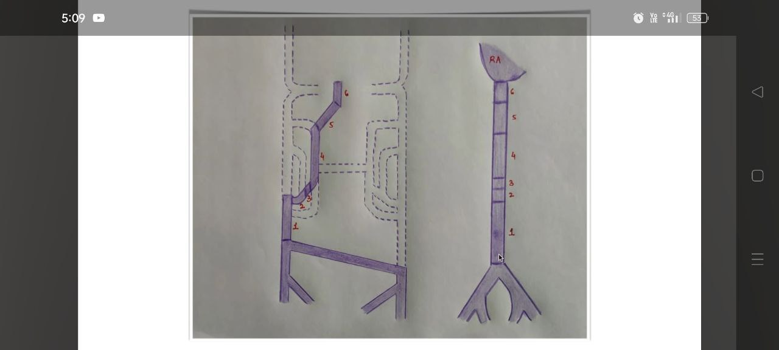

Slide 21
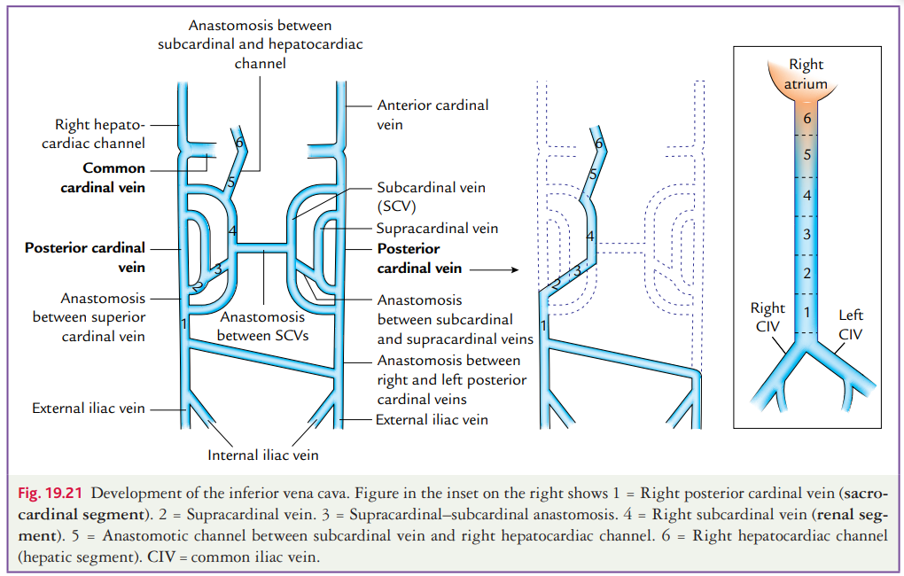

Slide 22
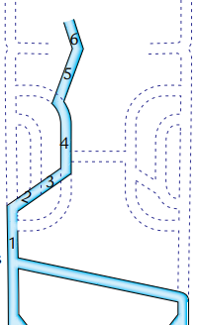
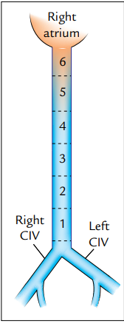
Formation of Inferior vena cava (IVC)
It is the largest vein of the body and develops from six components.(From caudal to cranial these components are)
1)Right posterior cardinal vein(sacrocardinal segment of IVC)
2) Caudal part of right supracardinal vein
3) Right supracardinal–subcardinal anastomosis
4) Right subcardinal vein (Renal segment of the IVC)
5) Anastomosing channel between right subcardinal vein to the right hepatocardiac channel
6) Right hepatocardiac channel

Slide 23
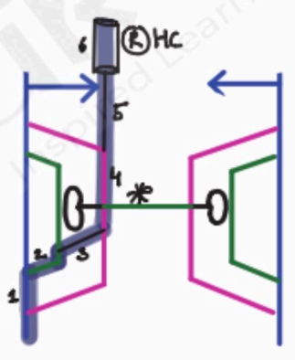
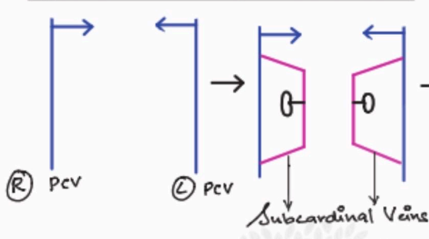
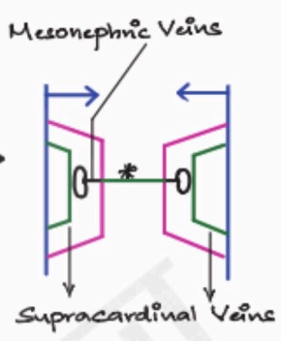
Rt Renal vein: Rt Mesonephric vein.
Lt Renal vein: Lt Mesonephric vein+Lt subcardinal vein+Intersubcardinal anastomosis
Suprarenal veins: Cranial portions of Subcardinal veins.
Gonadal Veins: Caudal portions of subcardinal veins.

Slide 24
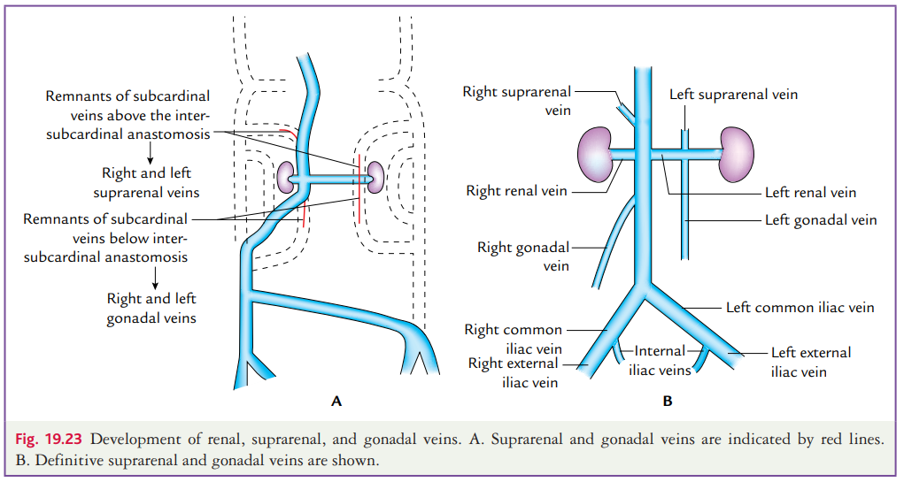

Slide 25
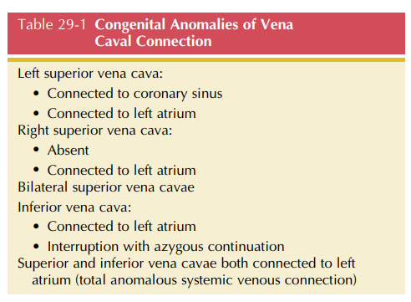
CONGENITAL ANOMALIES OF VENACAVA
Anomalous venacaval connections comprise a wide range of malformations that vary from minor to major.
It can occur in isolation or with coexisting congenital heart disease.
Persistent left superior vena cava occurs in 0.3% to 0.5% of the general population and in 4.3% (1.5% to 10%) of congenital heart disease.
Congenital heart malformations that show a high frequency of persistent LSVC are Tetralogy of Fallot (11%), Atrio ventricular septal defects (19%), Mitral atresia (17%) , and Juxtaposition of the right atrial appendage (RAA) (34%).

Slide 26
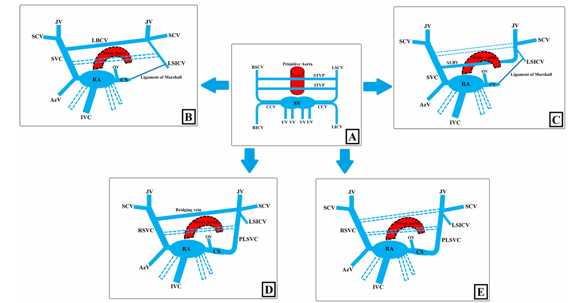

Slide 27
Hypotheses regarding the development of PLSVC
1) “Low left atrial pressure theory”: Anomalies such as atrioventricular septal defect (AVSD), which cause reduced left atrial pressure and insufficient development of the left atrium, the left atrium will be smaller than expected.
Thus, it will not be able to compress the CS and left CVs adequately.
So the left common cardinal vein and caudal part of the left superior cardinal vein will not regress, and PLSVC will develop.
2) “Obstructive theory” suggest the vice versa. Due to the presence of PLSVC, which may cause an increase in CS size, could lead to the formation of a left-sided obstructive lesion because of the space restriction

Slide 28
FACTS RELATED TO PLSVC
PLSVC is responsible for approximately 20% of the total venous blood return from the left arm, left half of the head and neck.
The right atrial drainage is seen in 80-90% of cases, while the left atrial drainage accounts for the remaining 10–20%.
Generally, it joins into the right atrium through the CS and mostly has no hemodynamic effects.
In up to 90% of the cases, the right superior vena cava (RSVC) accompanies PLSVC, and this situation is known as double SVC (DSVC)
In cases of DSVC, dimensions of RSVC is usually larger but can be smaller than PLSVC.
In 65% of the cases, DSVC runs along each side of the mediastinum without interconnection.
However, there could be the left brachiocephalic vein (LBCV) connecting them, which is also called the Bridging vein (BV)

Slide 29
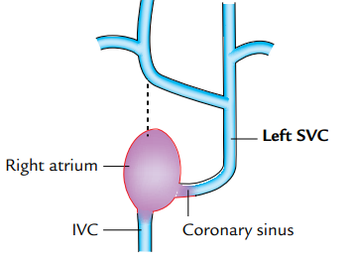
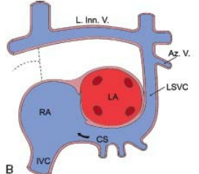
Isolated Left Superior venacava
It occurs when the anastomosis does develop between the two anterior cardinal veins, but the blood is shunted from right to left through brachiocephalic vein.
As a result, the right anterior cardinal vein below the oblique transverse anastomosis regresses and the left anterior cardinal vein develops into the superior vena cava.
The left superior vena cava opens into the coronary sinus.
An isolated left superior vena cava produces no problems when it drains into the right atrium via the coronary sinus

Slide 30
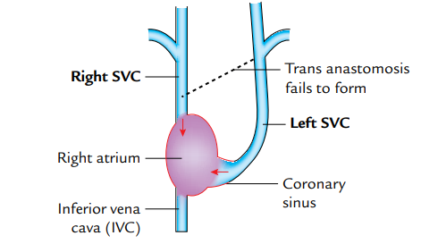
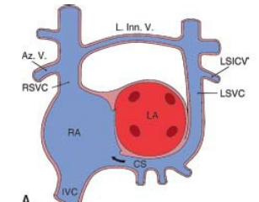
Double superior venacava
It occurs when both the anterior cardinal veins develop in to SVC.
The left superior vena cava opens into the coronary sinus, which in turn opens into the right atrium.
There may or may not be a bridging vein connecting them.

Slide 31
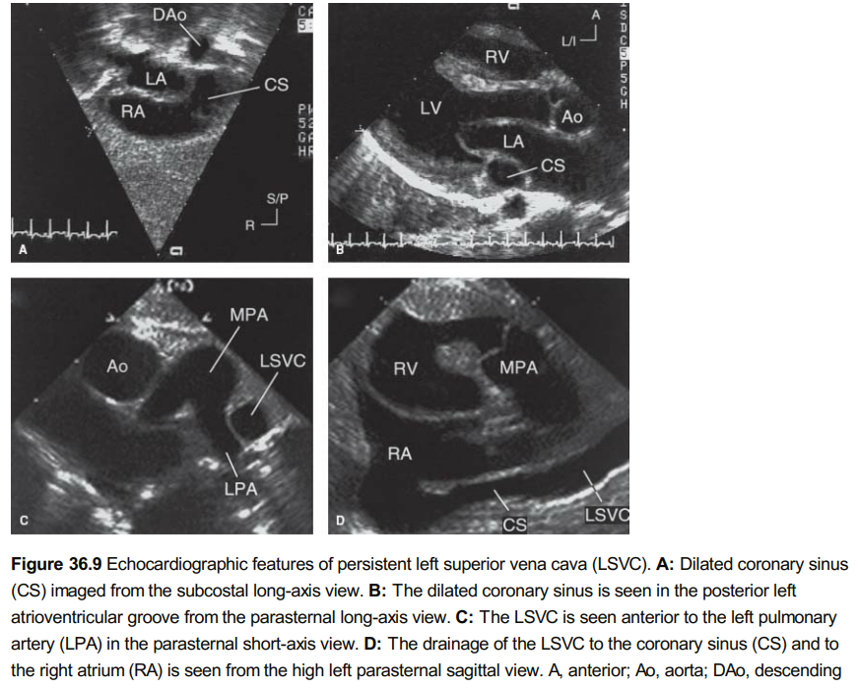
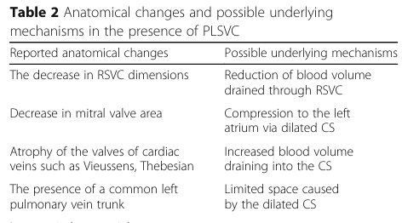

Slide 32
Clinical importance of PLSVC
PLSVC without congenital anomaly is generally asymptomatic and is detected as an incidental finding.
In the case of PLSVC with right atrial drainage, the CS often expands and this enlargement may cause
1)compression of the AV node and His bundle- lead to cardiac arrhythmias, such as atrial/ventricular fibrillation
2)The compression of the left atrium and decreased cardiac output may occur due to this enlargement.

Slide 33
It is crucial to know the PLSVC existence in advance in invasive procedures, such as central venous catheter (CVC) insertion, cardiac resynchronization therapy leads, or pacemaker implantation.
It may complicate these procedures because of the tortuous course.
When there is constriction or atresia of the CS ostium associated with LSVC, catheterization will be further more challenging and it may result in serious complications, such as dangerous arrhythmias, cardiogenic shock, and tamponade.
In the case of unknown PLSVC, retrograde cardioplegia, a common practice for cardiac surgeries for myocardial protection, will be ineffective.
Clamping of PLSVC may be required for the prevention of retrograde flow.

Slide 34
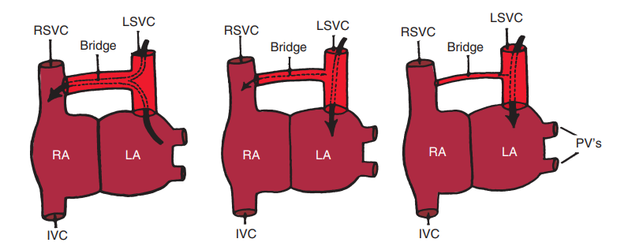
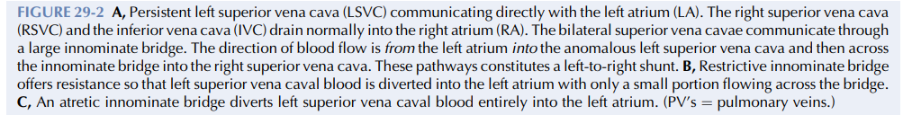
LEFT SVC DRAINING IN TO LA

Slide 35
The left atrial drainage of PLSVC some times, remains asymptomatic because it does not cause a significant right → left shunt.
When the shunt is more pronounced → desaturation, which manifests as severe cyanosis, syncope, reduced exercise tolerance, and progressive fatigue.
Thromboembolic events and even brain abscesses may develop in these patients.

Slide 36
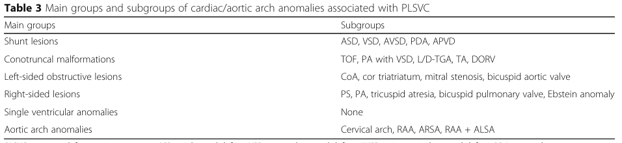
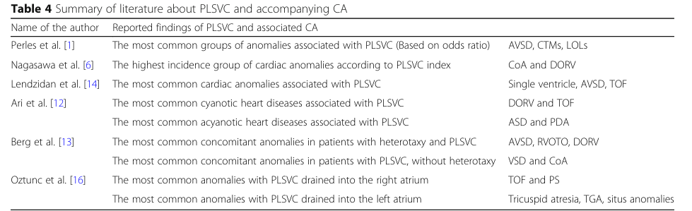
PLSVC and accompanying cardiac anomalies

Slide 37
PLSVC and heterotaxy
PLSVC is present in 50-70% heterotaxy syndrome. [situs inversus and situs ambiguus (right/left isomerism)].
Berg et al. reported that they never saw CS dilatation in the heterotaxy group, which is a well-known sonographic finding supporting the presence of PLSVC.
The absence of CS dilatation has been associated with unroofed CS, which is found in almost all heterotaxy cases.
It should be kept in mind that the absence of CS dilatation does not exclude the presence of PLSVC in patients with heterotaxy during the antenatal period, as there is a high possibility of associated unroofed CS.

Slide 38
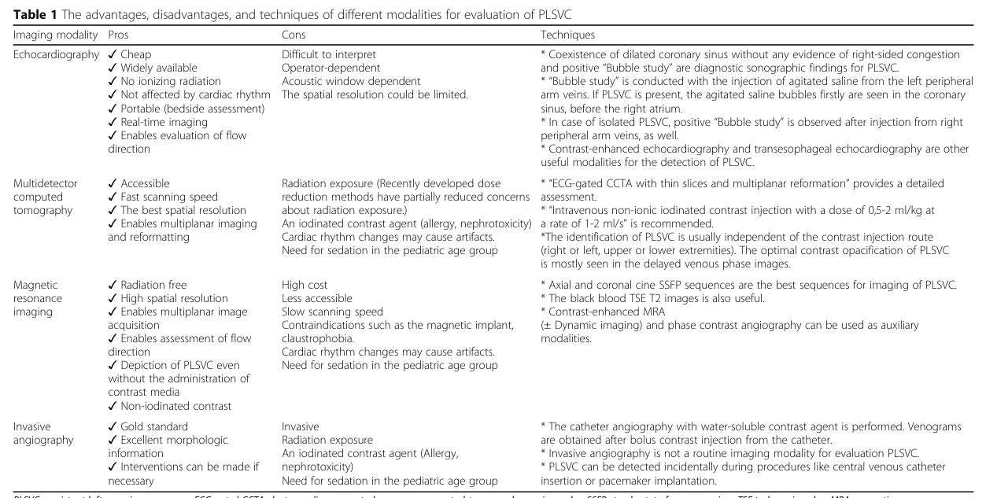

Slide 39
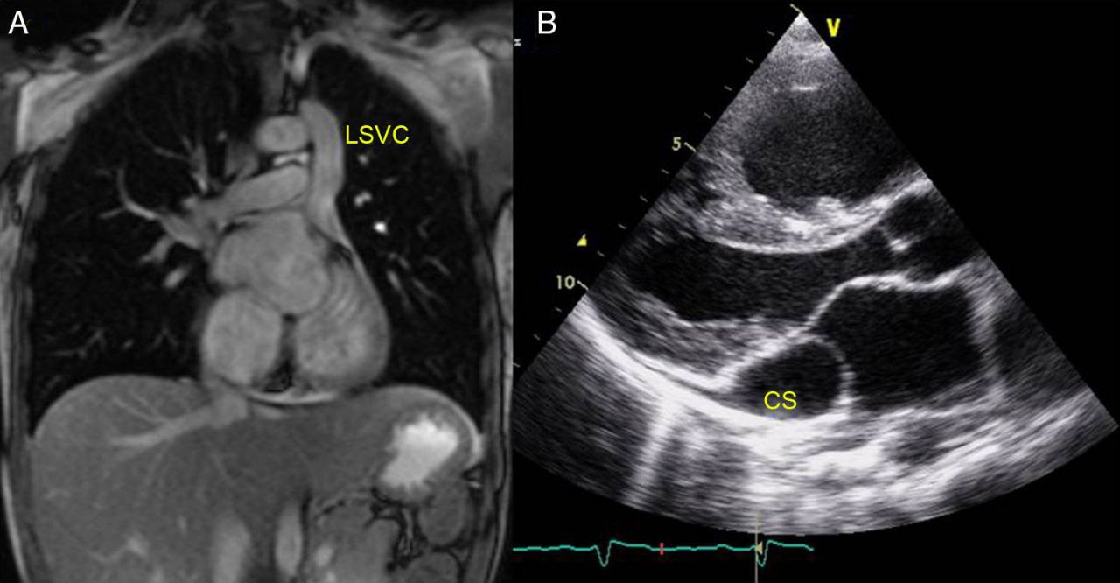
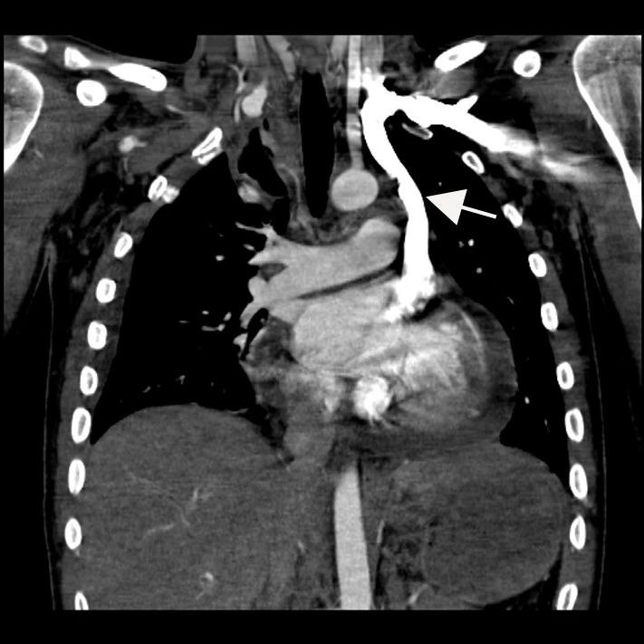
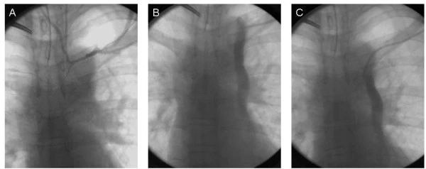

Slide 40


Slide 41
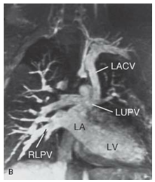
LEVO ATRIAL CARDINAL VEIN (D/D of LSVC)
LACV is a remnant of an early embryonic venous channel that connects the splanchnic plexus of the lungs with the cardinal system.
In the mature heart, it connects the LA or a pulmonary vein with the left innominate or other systemic veins.
It is associated with severe left atrial outlet obstruction, such as mitral stenosis or atresia.
The diagnosis can be established by following the anomalous vein from its origin (either from the LA or from one of the pulmonary veins) to its termination in a systemic vein.
PLSVC courses anterior to the left pulmonary artery where as LACV typically ascends posterior to left pulmonary artery.

Slide 42
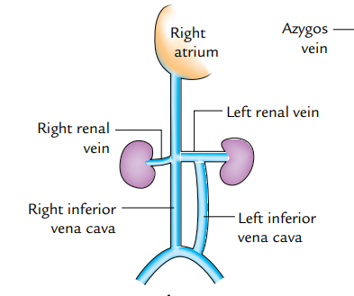
Double inferior venacava: It occurs because the anastomosis between two posterior cardinal veins does not develop.
Hence the left posterior cardinal vein below the level of the renal vein develops into the inferior vena cava while normal inferior vena cava develops on the right side.
As a result, inferior venacava is duplicated only below the renal veins.
The left inferior vena cava opens into left renal vein.
B/L IVC is associated with Visceral heterotaxy with asplenia

Slide 43

Interrupted IVC with azygous continuation:
Absence of the hepatic segment of the IVC with azygos continuation into the right or LSVC is referred to as an interrupted IVC.
It has no physiologic significance but can be mistaken for the descending thoracic aorta.
Interruption is immediately proximal to the renal veins and then it continues as a dilated azygos vein that enters the thorax to the right of the aorta, and connects to a right superior vena cava.
Interruped IVC is associated with Visceral heterotaxy with polysplenia

Slide 44



Slide 45


Slide 46



Slide 47



Unroofed Coronary Sinus
Fenestrations or Unroofing of CS will establish a connection between LA to CS.
Blood will flow from LA→CS→RA. [Left →Right Shunt].
Most often, this defect is associated with Left superior venacava.
Drainage of LSVC→LA will result in admixture→Cyanocis .
LSVC→LA→CS→RA
This is a rare situation were there is cyanocic with a left to right shunt.

Slide 48



Coronary Sinus Orifice Atresia

Slide 49



(E) PLSVC and atrial septal defect. (F) PLSVC and a variety of persistent common atrioventricular canals. The atrial septal defect involves the entire lowermost portion.

Slide 50

Venous drainage of heart
Topographic Classification
1) Coronary sinus and its tributaries
2) Anterior cardiac veins
3) Thebesian veins.

Slide 51
MODERN SYSTEM OF CLASSIFYING CORNARY VENOUS SYSTEM
1)Greater Cardiac venous system
Coronary sinus and its tributaries Anterior cardiac Veins
2)Lesser Cardiac venous system
THEBESIAN VESSELS

Slide 52
Greater Cardiac venous system
These are large venous vessels
They drain the sub epicardial myocardium
They travel along the atrioventricular and interventricular grooves
They have venous valves are located at the venous ostium
They ultimately drain into RA

Slide 53
Lesser Cardiac Venous system
This system is made up of Thebesian vessels.
They are responsible for the drainage of the deoxygenated venous blood from sub endocardial and intramural myocardium.
They directly drain into any one of the 4 cardiac chambers.

Slide 54

Four types of Thebesian veins have been described;
  Venoluminal:drain directly into the cardiac chambers
  Venosinusoidal:drain into subendocardial sinusoids (which, in turn, drain into the cardiac chambers)
  Arterioluminal:connect small arteries and arterioles directly with the cardiac chambers
  Arteriosinusoidal:connect thin arteries or arterioles with subendocardial sinusoidal spaces

Slide 55
Tributaries of Coronary sinus
1.Great Cardiac Vein(V.Cordis Magna/Left Coronary Vein)
2.Small Cardiac Vein (V.Cordis Parva/Righ Coronary vein)
3.Middle cardiac Vein (V.Cordis Media)
4.Posterior vein of left ventricle (V.Ventriculi sinistri)
5.Oblique vein of Marshall (Oblique vein of left atrium)
6.Right Marginal vein.

Slide 56


Great Cardiac Vein: It runs in the anterior IV groove (Accompany LAD), then it winds around the left heart border to enter left posterior AV groove (Accompany Lcx) to end in the left end of CS.
Right Marginal vein: Run along the inferior boarder of heart(Accompany Rt Marginal Ar)
It then winds around the inferior boarder to enter Rt posterior AV groove and continues as Small cardiac Vein (accompany RCA) and ends in right end of CS.

Slide 57


Left Marginal vein: Runs along with the Left marginal branch of Lcx, and it ends in Great Cardiac Vein.
Middle Cardiac Vein: Runs in the Posterior IV groove (Accompany PDA).
Posterior Vein of LV: drain posterior wall of LV, directly end in CS.
Oblique Vein of LA: drain the posterior wall of LA.

Slide 58
Anterior Cardiac Veins: These are series of small veins (3 or 4) which run parallel to each other across the surface of right ventricle to directly open into anterior wall of the right atrium.
Venae cordis minimae (Thebesian veins): These are extremely small veins in the walls of all the four chambers of the heart.
They open directly into the respective chambers.
They are most numerous in the right atrium

Slide 59



Slide 60


CORONARY SINUS
Coronary sinus develops from the left horn of sinus venosus.
Situated In the posterior AV grove (posterior coronary sulcus).
It is formed by the union of Great cardiac vein with the Posterolateral vein.
The length of the CS can vary from 3 to 5.5 cm and is dependent on the site of the drainage of the Posterolateral vein.
It ends at the ostium of CS at the RA.

Slide 61


Valve which is situated at the ostium of CS is called Thebesian Valve.
Ostium of CS is 5–15 mm in diameter and is located on the posterior wall of RA , anterior to the Eustachian valve and posterior to the tricuspid annulus.
Histology: Instead of smooth muscles forming the tunics media, it has striated myocardium which is continuous with that of atrium, forming a myocardial sleeve around the vein.
It helps in the transfer of blood from CS to Rt atrium by active contraction.

Slide 62
CLINICAL IMPORTANCE OF CS
CS is an electrophysiologically active structure.
Studies have demonstrated the capability of spontaneous depolarization and slow conduction in the smooth muscle of the CS (inherent automaticity).
Active myocardium within the CS may serve either as a source for abnormal automaticity, generating a focal tachycardia or as a part of a reentrant circuit.
CS myocardium may also initiate recurrent atrial fibrillation, although the myocardial sleeve around pulmonary veins are more common source.

Slide 63
Diagnostic and therapeutic uses of CS
Canulation of CS is used in
  Cardiac resynchronization therapy
  Retrograde cardioplegia delivery
  Arrhythmia mapping
  Catheter ablation of arrhythmias
  Percutaneous mitral annuloplasty

Slide 64

CORONARY VENOGRAM
Coronary venous circulation can be seen in the Levo phase of CAG.
Coronary artery → Capillary → Veins→ CS→ RA
To get a better visualization of Coronary venous system, balloon occlusion angiography of CS can be done, canulating CS retrogradely from RA.
This is usually done during CRT to localise a Posterolateral vein for placing the LV lead.

Slide 65




Slide 66



The CS is of interest to the electro physiologist because it provides a useful route for mapping and ablation of left-sided accessory pathways.
Decapolar catheter

Slide 67
Retrograde cardioplegia
Technique used to deliver cardioplegic solution to the heart.
It involves insertion of a catheter into CS and delivering the cardioplegic solution through it.
It allows even distribution of the solution through out the heart muscle and provide optimal protection during surgery.
Studies have found that retrograde cardioplegia helps to reduce the risk of cardiac arrythmias,reduce the need of inotropic support and it improves overall outcome of the surgery than anterograde cardioplegia.

Slide 68



Perctaneous Transvenous Mitral annuloplasty
Coronary sinus is located parellell to the posterior portion of mitral ring and it surrounds up to 2/3rd of the ring, making it possible to implant devices through this route for the treatment of MR.

Slide 69

In refractory angina
Patients with CAD, those who are not candidates for revascularisation, but suffering from refractory angina despite medical therapy, may be treated with CS reducer devices.
It creates focal narrowing and thus increase pressure inside coronary sinus to redistribute blood into ischemic myocardium.

Slide 70
PICAB(Percutaneous Insitu Coronary Artery Bypass)
Technique in which a conduit is created between proximal coronary artery and a vein in order to supply oxygenated blood to ischemic myocardium.
Vein is entered from artery proximal to obstruction and the artery is re entered from the vein distal to the obstruction.
This segment of the vein will act as bypass.

Slide 71


PICVA (Percutaneous Insitu Coronary Venous Arterialization)
In this procedure, a fistula is created from the artery proximal to obstruction to the coronary vein using a self expanding connector.
The proximal vein is plugged off to prevent the steal of blood into CS.
This will force retroperfusion of the myocardium through coronary vein.
This procedure has been done successfully between Proximal LAD and Anterior Interventricular vein to perfuse anterior wall.

Slide 72

Coronary sinus aspiration to reduce contrast induced AKI
Then a balloon tipped catheter is introduced in to CS.
Balloon was inflated in proximal CS (near the ostium) before contrast injection.
Once contrast reach CS→Aspirate→Deflate the balloon.
This method is useful in patients who are at risk of contrast induced AKI

Slide 73


Post Dual Chamber PPI
RBBB Morphology in ventricular paced complexes
Always consider RV lead misplacement in CS as 1 of the possibility

Slide 74
CORONARY SINUS DIVERTICULUM
It is a rare congenital anomaly where a pouch or sac forms in the CS.
The aneurysm is seen as an out pouching, typically with a distinct neck, which extends behind the left ventricle or into the ventricular myocardium
It can be a source of arrhythmias including AF or Ventricular tachycardia.
It is estimated to occur in 7-11% of patients with posteroseptal accessory atrio ventricular pathways.(Hence it more commonly found in patients with WPW syndrome)
It can be treated by radiofrequency catheter ablation
In some cases, surgery may be needed to repair the diverticulum.

Slide 75



Slide 76

Oblique Vein of LA
The largest atrial vein
Arise opposite to the posterolateral vein
This branch is an embryological remnant of the left superior venacava
Left anterior cardinal vein-when patent through out→Left SVC
When it is partially occluded with a patent atrial course: Vein of Marshall
Vein of Marshall is present within Ligament of Marshall, which contain fibro fatty tissue, sympathetic nerve fibres, ganglia and some myocardial tissues.

Slide 77

Marshall’s ligament can generate ectopic focus for triggering paroxysmal atrial fibrillation and atrial tachycardia.
Alcohol ablation of Vein of Marshall is used to treat AF and AT
Insert a catheter in VOM→Inflate a balloon to occlude the vein→ Inject alcohol→Vein will shrink and close→disrupt abnormal electrical signals.

Slide 78

Great Cardiac Vein
It is the longest vein of the heart and most constant vein of heart.
2 parts:
Anterior Interventricular portion(Accompany LAD)
Basal portion(Left AV groove, accompany Lcx)
Lateral tributaries of anterior interventricular vein can be used to pace the left ventricular free wall.
Ablation within this vein is required for outflow tract ventricular tachycardia
The great cardiac vein tributaries are responsible for the drainage of
Left Atrium
Anterior wall of RV and LV
Apical regions of the myocardium
Interventricular septum

Slide 79

Middle Cardiac Vein
It is also called as Inferior/posterior Interventricular vein
Runs along with PDA in the posterior IV groove.
It drain the diaphragmatic surface of both ventricles.
It empties into the coronary sinus approximately 1 cm from the coronary sinus ostium.
Because of this, diverticulum or aneurismal dilation of this vein may occur with or without associated arrhythmias.

Slide 80

Thebesian Valve
Ostium of the coronary sinus have a ridge which is referred
to as Thebesian valve.
The valve originates from the embryonic right venous valve.
It is a crescent shaped structure found at the mouth of the CS, safeguarding the CS as it opens into RA.
It may obstruct the entry into CS while canulation of CS
Thus it can make it difficult to administer retrograde cardioplegia for CABG and also difficult to enter into CS for electrophysiologist.

Slide 81

The valve of Vieussens
It is the valve, which is situated at the end of the great cardiac vein and beginning of the coronary sinus, typically located at the ostium of posterolateral vein.
It is highly variable- It is found to be unicuspid in 72%, bicuspid in 25.6%, or tricuspid in 2.2% of the cases.
It produces obstruction to leads and catheters placed during cardiac procedures.

Slide 82


Slide 83
THANK YOU

